Slide 1
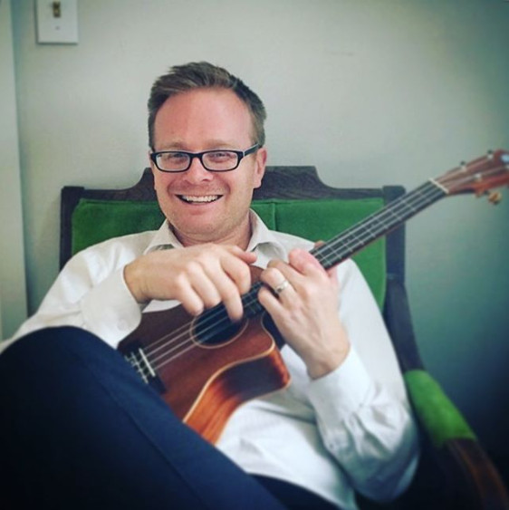





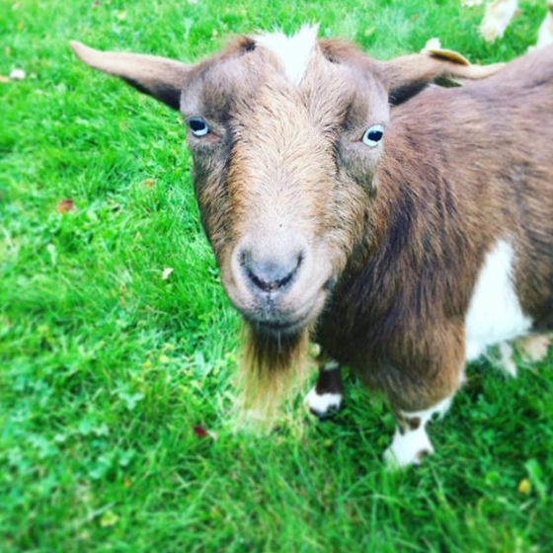


Adam L. Rich, FCAS
Loves music
Graduated from Brigham Young University, BS Math
Maybe a brony?
Work as an actuary at Beazley plc
Own a small farm
With lots of animals
And lots of kids
“Let’s just say that enthusiasm
won out over common sense…”

